Slide 1

OUR COMMUNITY,
OUR RESPONSIBILITY
Personnel Security Consultants, Inc. (PSC)
219 Central Avenue NW
Albuquerque, NM 87102
www.1stDefense.us
Notes:
Introduction
We are your 1st Defense Team.
We just want to take this opportunity to welcome you in joining our 1st Defense Background Screening team.

Slide 2
We are your 1st defense
We provide your team the tools and information you need to uphold the responsibility you have of hiring the “right” people for your program.
Notes:
We are here to help you gain all the information needed to make the best decision possible. We are just an extension of your hiring team.
We are going to start off covering the FCRA requirements to be followed.

Slide 3
Fair Credit Reporting Act
To Conduct an Inquiry You:
  MUST have a Permissible Purpose
  MUST have a Written Notice
  MUST have a signed Authorization for Release of Information form
Notes:
3
Here is an overview of the FCRA requirements-
You must have permissible purpose- which is Employment
Must have written notice that a background screening will be performed
And you must have a signed Authorization of Release of Information form on file
And lastly you must give the subject the opportunity to correct or refute any results found.

Slide 4
Fair Credit Reporting Act
4) If You Use 1st Defense Information to make an Adverse Decision YOU must provide the person the opportunity to refute, correct, explain the adverse information prior to making a Final Unfavorable Decision.
Notes:
4
What is adverse information? Any information that adversely reflects on the integrity or character of a cleared employee
Adverse Action Procedures
If you rely on a consumer report for an "adverse action" - denying a job application, reassigning or terminating an employee, or denying a promotion — be aware that:
Step 1: Before you take the adverse action, you must give the individual a pre-adverse action disclosure that includes a copy of the individual's consumer report and a copy of "A Summary of Your Rights Under the Fair Credit Reporting Act" — a document prescribed by the Federal Trade Commission. The CRA that furnishes the individual's report will give you the summary of consumer rights.
Step 2: After you've taken an adverse action, you must give the individual notice — orally, in writing, or electronically — that the action has been taken in an adverse action notice. It must include:
The name, address, and phone number of the CRA that supplied the report;
A statement that the CRA that supplied the report did not make the decision to take the adverse action and cannot give specific reasons for it; and
A notice of the individual's right to dispute the accuracy or completeness of any information the agency furnished, and his or her right to an additional free consumer report from the agency upon request within 60 days.

Slide 5
Fair Credit Reporting Act
You are Obligated to Protect:
Provided User IDs and Passwords
Personal Identifying Information
Information and Results provided through the 1st Defense System
Notes:
5
Client Responsibilities
-Must protect user ID’s and passwords
-Personal Identifying information or any results
-Must follow all FCRA requirements- previously listed.
-Must inform us of any changes in personnel so we can keep an update user list.

Slide 6
QUESTIONS FOR OUR TEAM?
Notes:
Does anyone have any questions about what we just covered? Great!!!
Moving on.
6

Slide 7
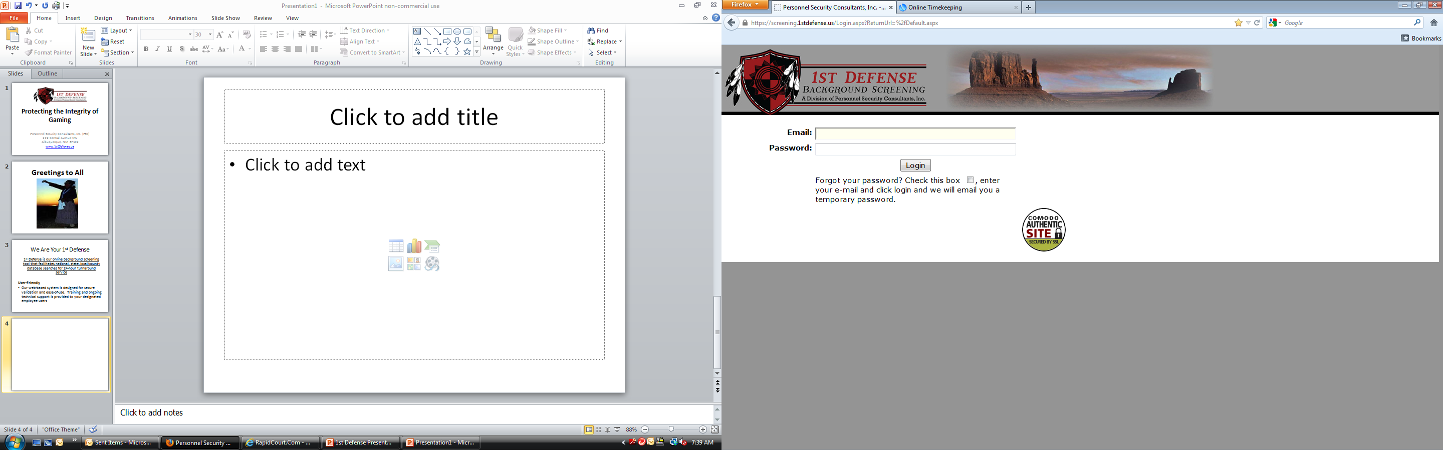
The login page
Notes:
Each registered user will receive an email with a link to our 1st Defense System along with their username and password. Once you sign in you will be immediately directed to change you password during your first log in.
-Enter your email address and password to log in. If you have forgotten your password, check the box underneath the Log-In button and a temporary password will be sent to you at the email address on record. And again you will be directed to change your password.
PASSWORDS: We follow the FCRA and FBI requirements for changing passwords every 6 months and having the strength of: Small cap, large cap, symbol and number.
DOES ANYONE HAVE ANY QUESTIONS ABOUT THIS PARTICULAR SCREEN? GREAT!
LET’S ALL MOVE ON TO THE NEXT SCREEN.

Slide 8
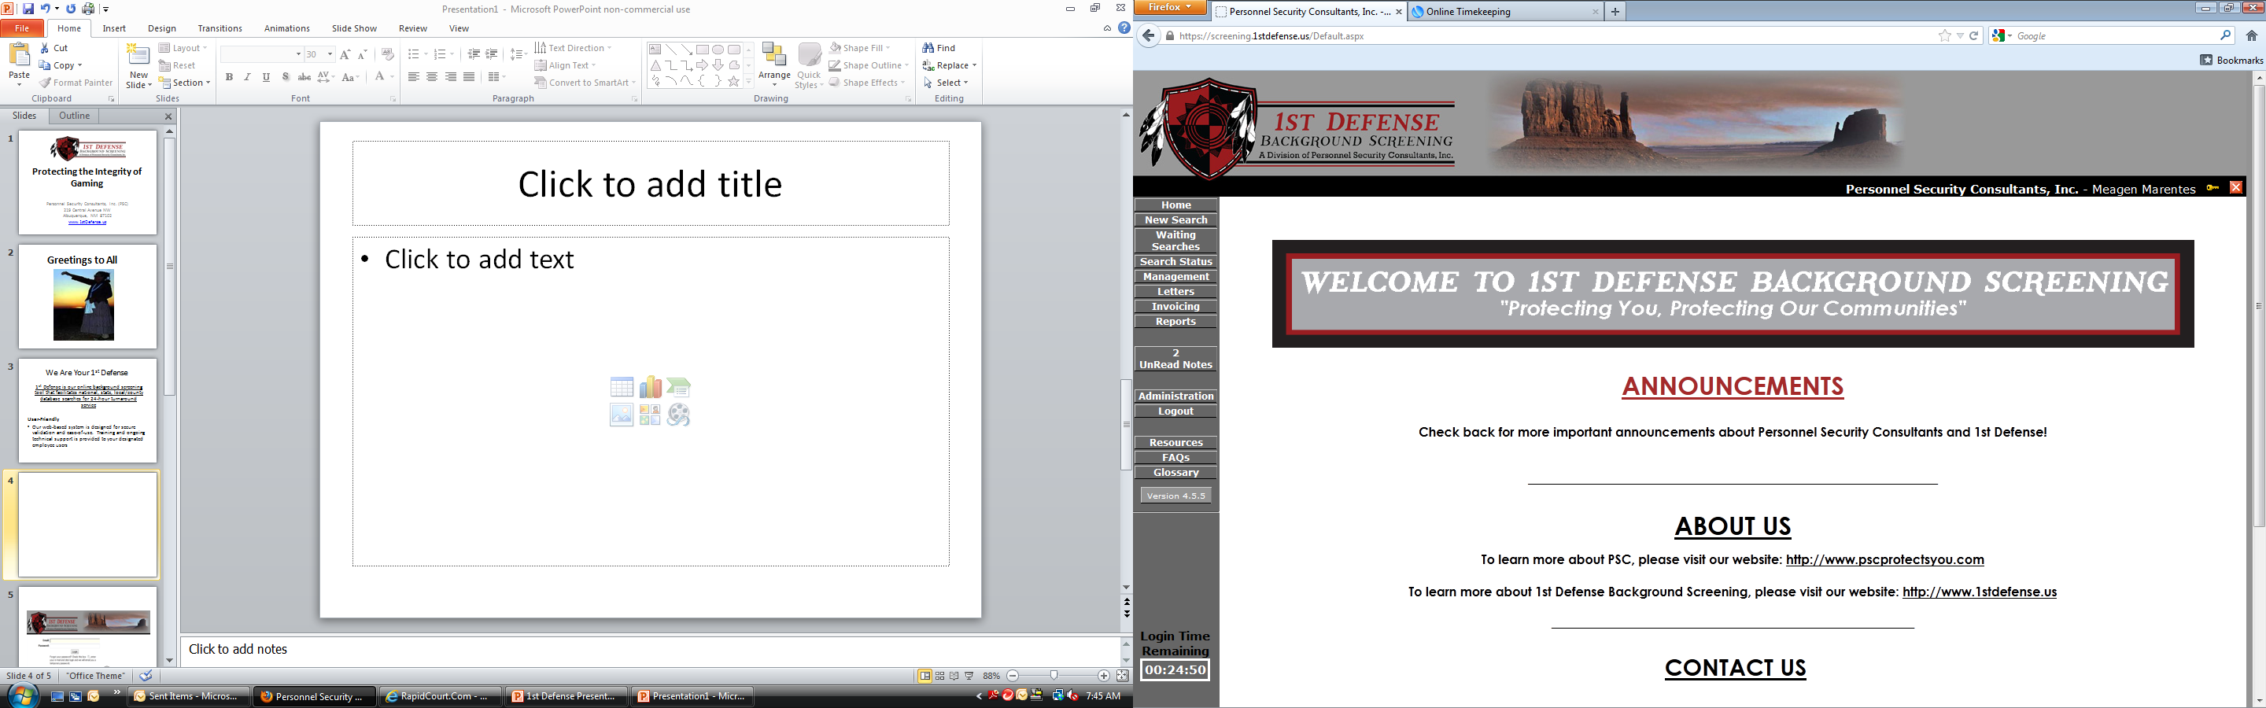
The WELCOME page
Notes:
Upon log in, you will be directed to the Welcome page. This page houses many benefits to your agency.
Announcements which will inform your agency if there are any court closures , delays, or updates regarding 1st Defense.
PSC & 1st Defense website Links as well as our contact information.
Customized Menu--????
Identification of our Program and User.---?????
DOES ANYONE HAVE ANY QUESTIONS ABOUT THIS PARTICULAR SCREEN? GREAT!
Moving on.

Slide 9
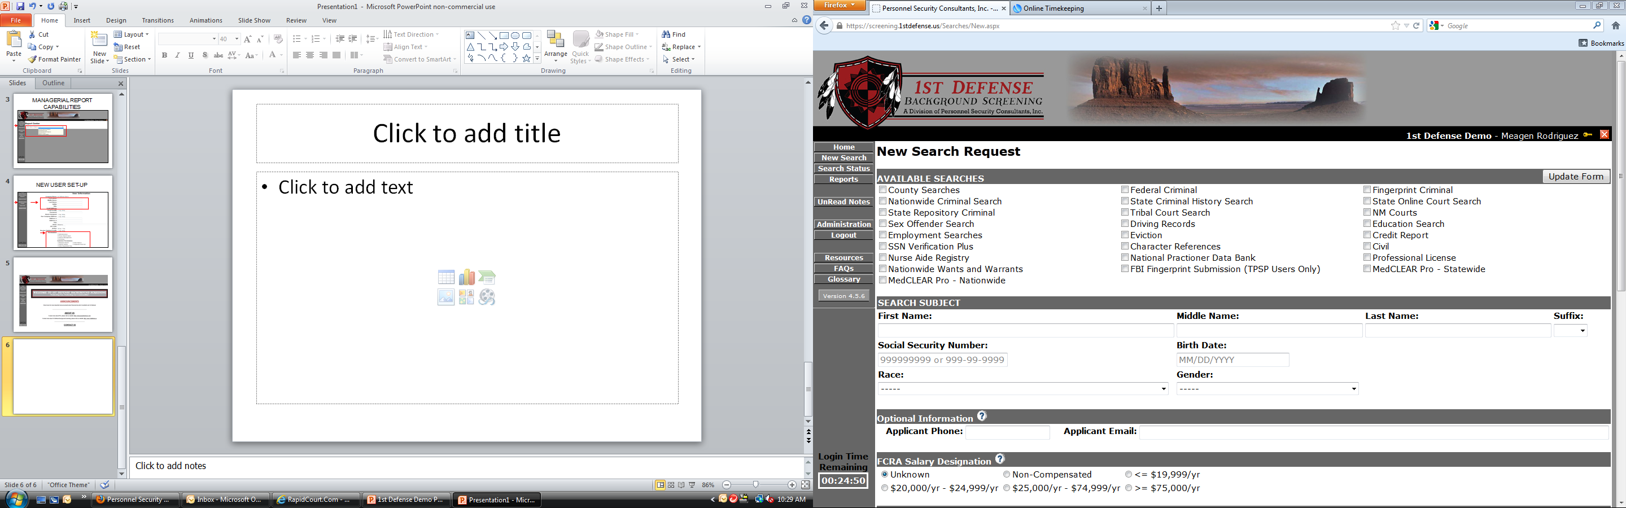
MENU OPTIONS
Notes:
This next screen highlights the Left Navigation Bar- This you will want to familiarize yourself with. It consists of:
Search Status
Unread Notes
Resources
Frequently Asked Questions
Glossary
In the upcoming slides we will cover the basics of each of these options.

Slide 10
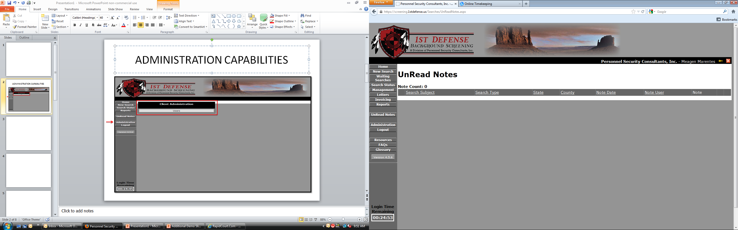
UNREAD NOTES
Unread Notes will show any requests for release forms depending on the search ordered.
Notes:
The unread notes are internal posts from our team to you, as well as any messages from you can be posted. This is just another communicating tool utilized to keep in contact with you.
In addition to UNREAD NOTES, our protocol is to call you, send you and email, and post a note.
If no response within three days, we will note that the search is unable to be performed due to an incomplete request.
Are there any questions regarding UNREAD NOTES?
Moving on to Resources.

Slide 11
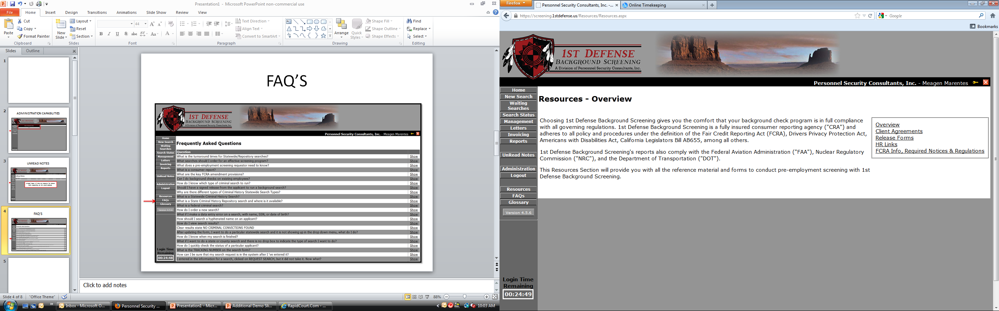
RESOURCES
Notes:
This Resource Section provides you with all the reference material and forms to conduct pre-employment screening.
You have:
The Client Agreement
Release forms
HR Links and the FCRA information, required notices, and regulations.
Does anyone have any questions?

Slide 12
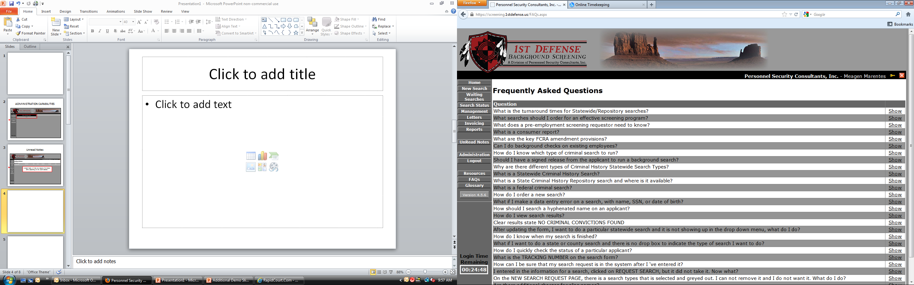
FAQ’S
Notes:
Next we have the Frequently Asked Questions- here we have listed questions and answers to common questions regarding pre-employment screening and questions regarding specific searches. When you have some extra time please review the Questions & Answers, it provides lots of beneficial information.

Slide 13
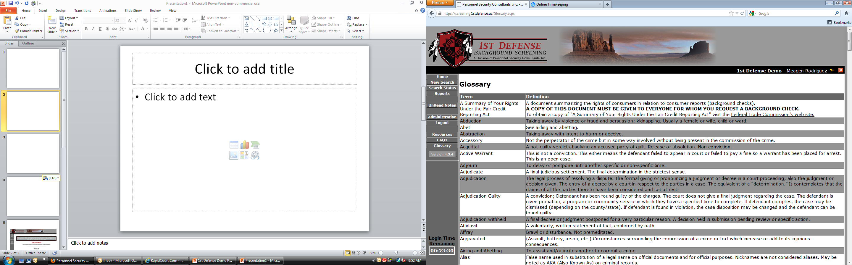
GLOSSARY OF TERMS
Notes:
Here we have the Glossary which lists the alphabetical terms described within the 1st Defense website along with the definitions for those terms. Please take separate time to review the glossary as it provides more beneficial information.

Slide 14
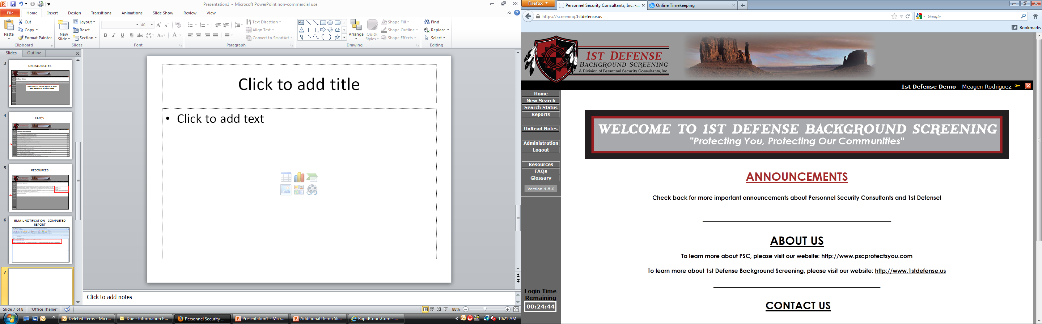
SYSTEM SECURITY
Built – In Timer for added security. Will automatically log you out if you have been in idle for over 25 minutes.
Notes:
We have some security safequard to help protect you and the subjects information. The LOGIN TIME REMAINING is for security purposes and you will be logged out if there is 25 minutes of inactivity. To reset the timer you just have to switch or update to a new page.

Slide 15
QUESTIONS FOR OUR TEAM?
Notes:
Are there any questions about what we just covered?
15

Slide 16
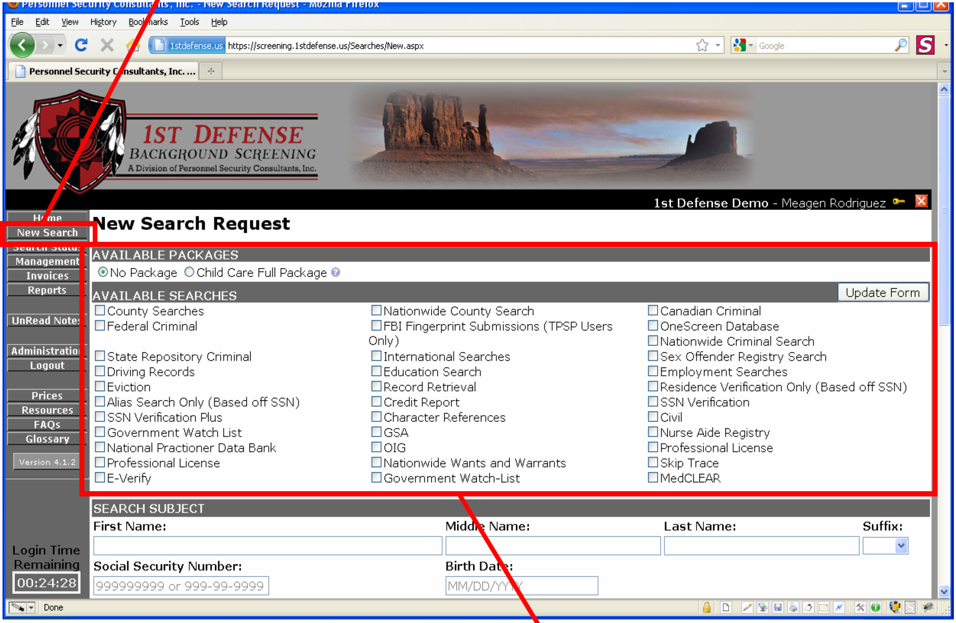
ORDERING A SEARCH
Notes:
To begin ordering new searches, simply click on the “New Search” tab from the left navigation bar.
Pre-designated packages and/or available search types are shown here. These were previously discussed during the agreement phase of becoming a new client of 1st Defense. In the Live Demonstration we will show you the exact ones you have selected to meet your screening requirements.
UPDATE FORM
Input information into required fields such as the Subjects demographics. This part is vital to outcome of the entire report. Please double check the Name, DOB, & SSN is entered correctly. We do not have the ability to change this information once the search order is placed.

Slide 17
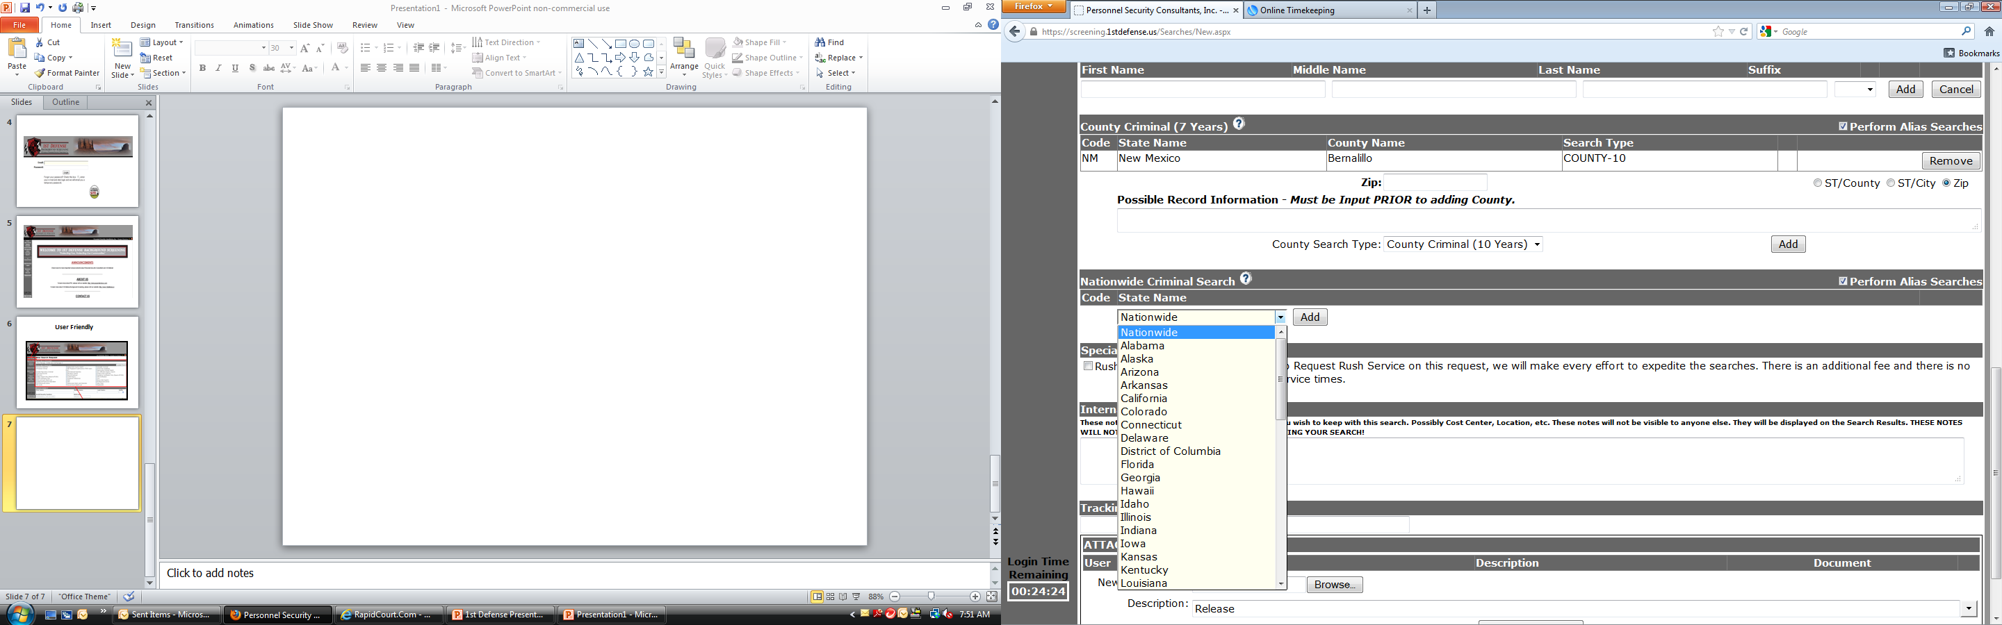
ORDERING A SEARCH
Notes:
Depending on the search, you will either be inputting information or choosing options through drop down boxes such as:
Search subject information
Personal Identifiers
States, Cities, or Zip Codes
A majority of the information you input for each search will be followed by an option to Save or Add. You must select save or add in order for the information entered to be linked to that search.

Slide 18
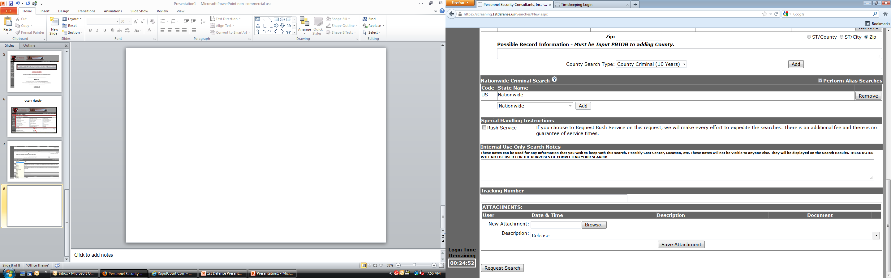
ORDERING A SEARCH
Notes:
“Rush” service capabilities cost $5.00 per search request. This is optional- times are never guaranteed based on the search type requested.
Order Tracking this is strictly for the use of your company. Example if you have Employee Numbers you can enter that here for employee record tracking.
The ATTACHMENTS section gives you the Ability Upload Release Forms or any other requested documentation.
To complete your searches click on “Request Search”.

Slide 19
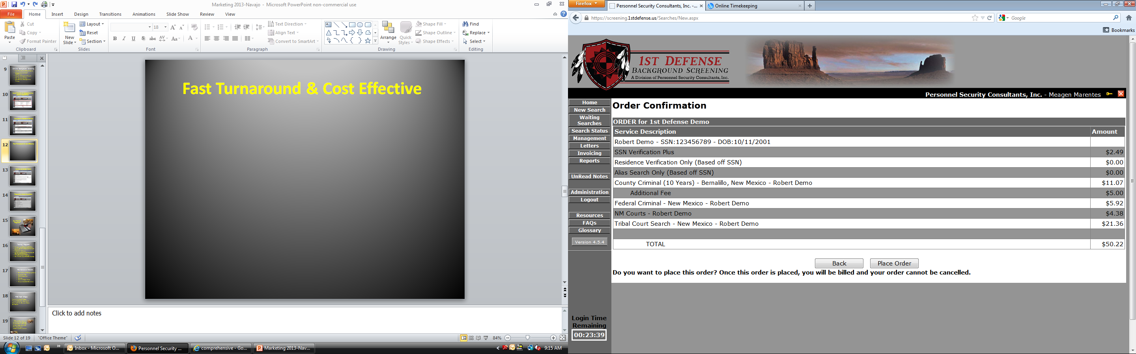
ORDER CONFIRMATION
Notes:
Screen is 1 of 2 confirmation pages. First Screen shot is not visible here but can be seen during our live demonstration.
The first screen to appear will be the services ordered and the options to
Modify Order- change any or update any incorrect information
Cancel Orders -
Confirm Order
Once you hit confirm order you will come to the second confirmation page. The one shown here.
Review entered data or Modify Selections, the prices will be reflected on the Order Confirmation Page.
Then you will Place Order.

Slide 20
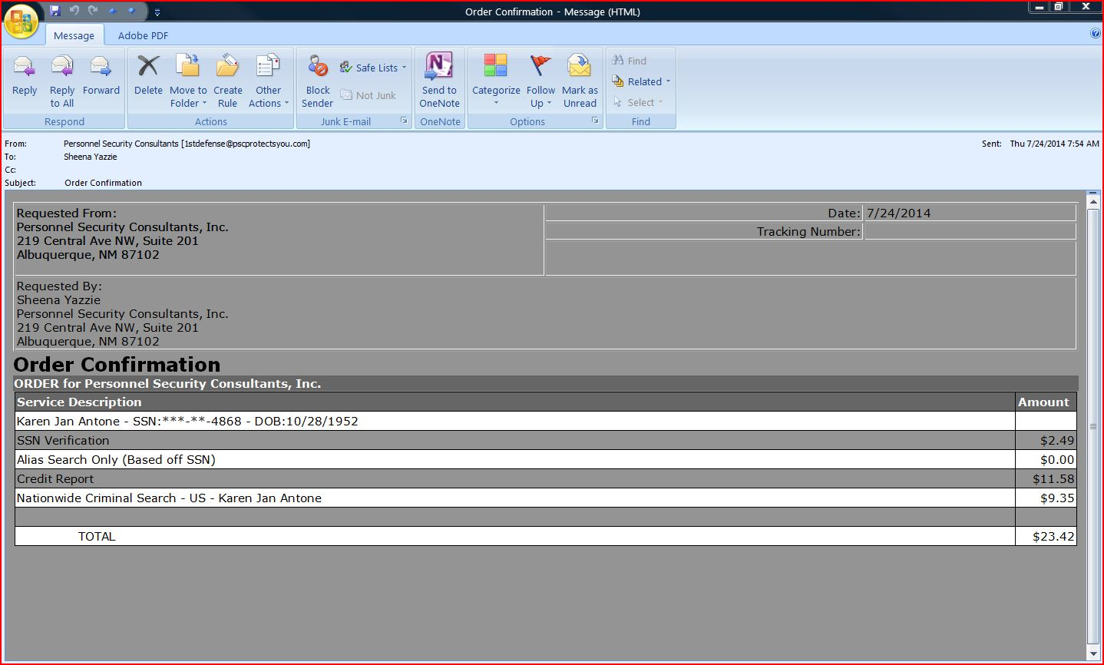
EMAIL NOTIFICATION
Notes:
Once you hit Place Order your order will be submitted and cannot be modified or canceled.
Then all registered user’s will receive a “Order Confirmation” email reflecting the request just submitted or placed.
From there you will be able to view the status on each subject.

Slide 21
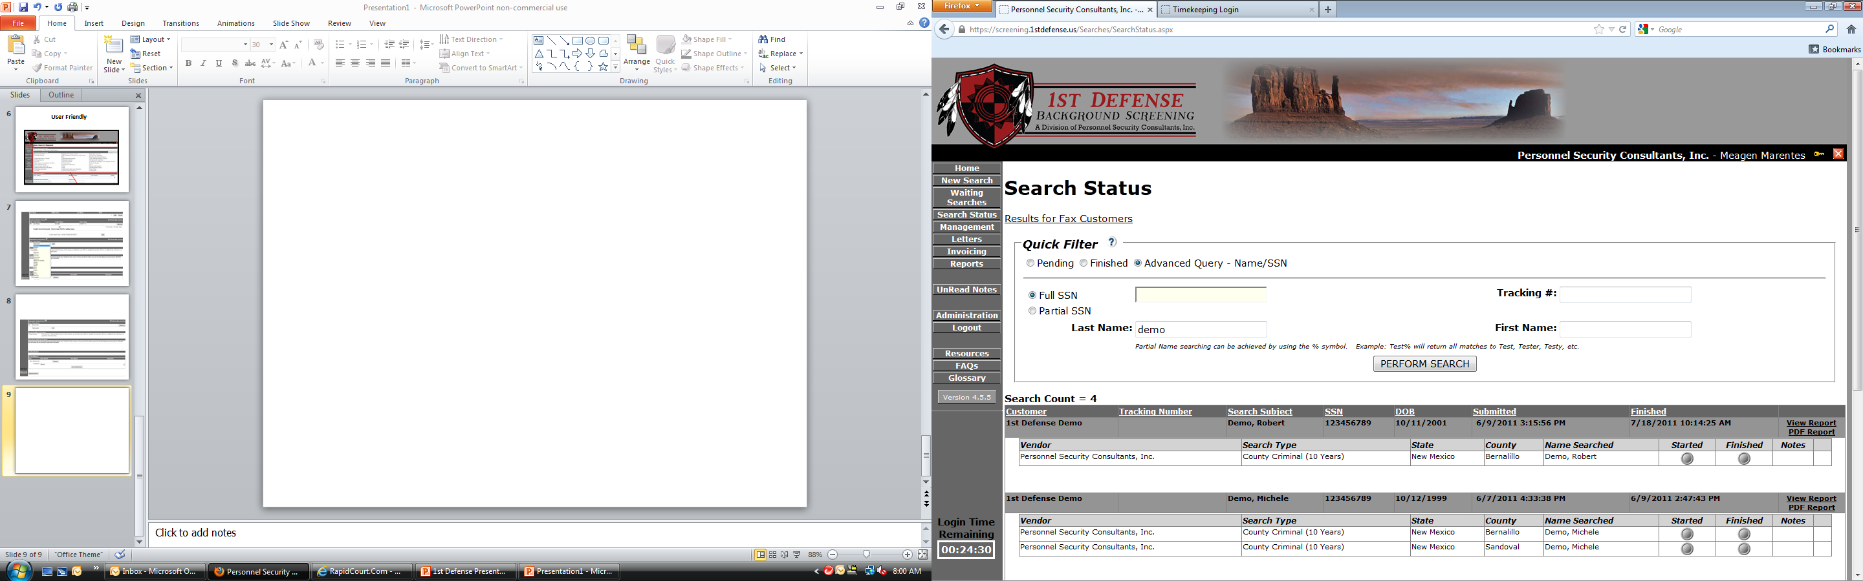
SEARCH STATUS
Notes:
Performing the Advanced Query search is the filter you will use to look up subjects. There the user’s can search by Full/Partial SSN, Tracking Number, Last Name and/or First Name.
Once the information to be searched is entered , click PERFORM SEARCH
The Search Status screen will show:
Name of the applicant, SSN, DOB, Date Submitted and Date Finished.
List of searches ordered for that individual
List of Started , Pending, and Finished searches
To view more detailed search status you will click on the “View Reports “ or “PDF Report”

Slide 22
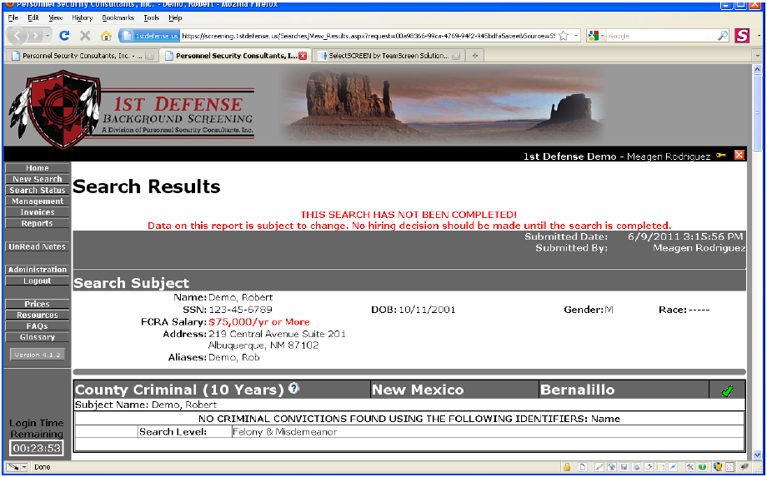
SEARCH RESULTS
Notes:
Here we are viewing the results in the “View reports” page. Another window opens in your browser to view the results. This view is recommended if you are just wanting a visual status.
If we viewed the Search Results in PDF Form – the reports would have opened up in an PDF reading programs such as Adobe and this view makes it easier to save results to your computer.
In the results you will find:
Search Subject Information
Date Started/Date Finished
Final Results for Searches Ordered and completed
As well as pending searches with updated notes.

Slide 23
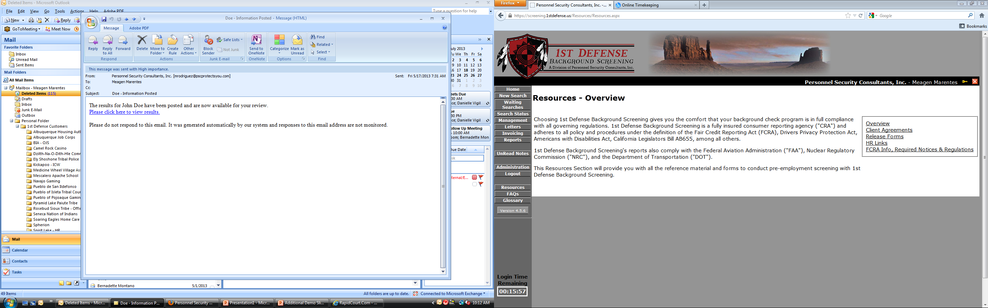
Results EMAIL NOTIFICATION
Notes:
Once all the searches have been completed 1st Defense will generate a completed report and all registered user’s will be notified by email of completed search report.

Slide 24
Live Demonstration
Fax: 505-243-8263
www.pscprotectsyou.com
www.1stdefense.us
Notes:
Thank People For Time
Answer Final Questions
Share How to Reach Us and identify any primary point of contact
24

Slide 25
Trouble shooting
Encoding Errors and Additional Requests for Information
Some original record holders require copies of Authorizations for Release, Special Forms, Additional Information. Please be prepared to submit to the 1st Defense Team for action.
Training and ongoing technical support is provided to your designated users.
Disputes and Requests for Information
We are obligated to research disputes or claims of errors within 3 days of notification
  to us by individual.
  ✓ Any confirmed errors will be corrected and revised.
  ✓ Individuals are entitled to their results at no cost, upon written request, and
  confirmation of their identity.
  ✓ Advise individual to contact PSC at 1-877-856-1329.
Notes:
Recap 1st Defense Value points

Slide 26
1st Defense Team
Karen: 505-214-9163, klovato@pscprotectsyou.com
Sheena: 505-214-9120, syazzie@pscprotectsyou.com
Liane: 505-214-9190, lgeiger@pscprotectsyou.com
Melissa: 505-214-9175, mbell@pscprotectsyou.com
1stdefense@pscprotectsyou.com
Fax: 505-243-8263
www.pscprotectsyou.com
www.1stdefense.us

Slide 27
Customer Service Team
Michele: President
Phone: 505-214-9159
Cell: 505 553-1844
Tony: Quality Control
Phone: 505-242-0848
Cell: 505 917-4208
Fax: 505-243-8263
www.pscprotectsyou.com
www.1stdefense.us
Notes:
As well as Michele the President of the company or Tony our Quality Control personnel.
27

Slide 28
QUESTIONS FOR OUR TEAM?
Notes:
Is there anything you would like to review further?
Do you have any final questions regarding 1st Defense?
28

Slide 29
THANK YOU FOR YOU PARTICIPATION
Notes:
Thank you for your time and we look forward to working with you as a pre-employment screening team. Please do not hesitate to contact Sheena or myself if you have any questions or concerns. We are here to help.
29

